Slide 1
Classifying Adverse Event Seriousness using NLP Capstone
Gan Tze Ling
DSI-25

Slide 2
Problem Statement
As a data scientist in a consultant firm to the Health Authority in Singapore, we have been tasked to create a model to differentiate between serious and non-serious adverse events (AE) using Natural Language Processing (NLP) from reports obtained from various sources.
The following models will be tested as potential candidates:
Logistic Regression
Naive Bayes - Multinomial
Random Forest Classifier
Ada Boost Classifier
Support Vector Machine (SVM)
A successful model is defined as having an accuracy and F1 score of at least 0.7.
Notes:
F1 score gives the harmonic mean of precision and recall metrics, hence offering a better overall measure of model performance as compared to just using precision or recall alone.

Slide 3
TABLE OF CONTENTS
01
02
INTRODUCTION & DATA CLEANING
EXPLORATORY DATA ANALYSIS & PRE-PREPROCESSING
03
04
MODELLING & MODEL EVALUATION
CONCLUSIONS & RECOMMENDATIONS

Slide 4
01
INTRODUCTION
Background
Dataset
Data Cleaning

Slide 5

BACKGROUND
DRUG SAFETY
ADVERSE EVENT
VAERS
After regulatory approval of a drug, the ongoing process of post-market surveillance ensures continued safety of the product
Harmful or negative outcome that occurs when a patient has been provided with medical care or treatment
Vaccine Adverse Events Reporting System (VAERS) is national warning system in the US to detect possible safety problem in US-licensed vaccines
Notes:
Let’s go through some definitions to better understand the background
Firstly for drug safety, after a drug has been approved by regulatory authorities, there is an ongoing process of post-market surveillance ensures continued safety of the product after introduction into the market
An adverse event is a harmful or negative outcome that occurs when a patient has been provided with medical care or treatment
VAERS is a national warning system in the US to detect possible safety problem in US-licensed vaccines

Slide 6
Reporting of an Adverse Event
2. Product Administration
1. Product approval
Efficacy and safety have been tested in clinical trials
Patient is given the drug or vaccine
3. Adverse Event
4. Reporting
Patient could experience a side effect of the drug
AE is reported by anyone (patient, family, HCP)
5. Signal Detection
6. Action Taken
If there is a high incidence of a particular AE, it could be detected as a signal for regulatory action
Regulatory authorities together with the company will determine what is the best course of action (e.g. Advisory, Recall)
Notes:
This is the general process of reporting of an adverse event
When a product is approved by the regulatory authorities, safety and efficacy of the product has been tested in clinical trials and the product is now in the market
The patient is then administered the drug or vaccine in our case
And some patients may experience a side effect after being administered the vaccine
The adverse event is then reported to the HA by anyone (patient themselves, family members or HCP to name a few eg)
If there is a high incidence of a particular AE, this would be detected as a signal for regulatory action
The regulatory authority would work together with the drug company to determine a suitable next course of action, which could involve issuing an advisory or even drug recall

Slide 7
INITIAL DATASET
Taken from VAERS
Data Collected in 2021 (up to Oct)
From 3 CSV files
FEATURES
DESCRIPTION
52
830k
COLUMNS
ROWS
45 Non-text columns
7 Text Columns
Notes:
This dataset is taken from VAERS and covers data in 2021 up to October
It contains a total of 52 columns and 830 thousand rows taken from 3 csv files
It contains 25 non-text columns and 7 text columns

Slide 8
DATA CLEANING
Filtering COVID-19 Vaccines
Removal of Duplicates & Imputing or Removal of Null Values
Cleaning of Text Columns with Regex
Notes:
Data cleaning included filtering covid-19 vaccines
removal of duplicates, imputing or removal of null value rows
And cleaning of text columns with regex
Regex: clean special characters, digits and non-English symbols

Slide 9
TYPES OF AE REPORT
NON-SERIOUS
SERIOUS
Common non-serious AE include
headache, fever, nausea
Generally more serious, falls into one of the serious criteria
Notes:
There are 2 main types of AE reports: serious and non-serious
Common NS AE include headache, fever and nausea
Serious AE generally fall into one of the following serious criteria as shown in the next slide

Slide 10
SERIOUS CRITERIA
Death
Life-threatening
Hospitalisation (initial or prolonged)
Disability or Permanent Damage
Congenital Anomaly or Birth Defect
Other Serious (Important Medical Events (IME))
Notes:
Serious criteria includes:
Death
Life-threatening – patient at substantial risk of dying bc of AE
Hospitalization (initial or prolonged)
Disability or Permanent Damage – resulted in a substantial disruption of a person's ability to conduct normal life functions, i.e., the adverse event resulted in a significant, persistent or permanent change, impairment, damage or disruption in the patient's body function/structure, physical activities and/or quality of life.
Congenital Anomaly/Birth Defect - exposure to a medical product prior to conception or during pregnancy may have resulted in an adverse outcome in the child.
Required Intervention to Prevent Permanent Impairment or Damage (Devices)- permanent impairment of a body function, or prevent permanent damage to a body structure, either situation suspected to be due to the use of a medical product.
Other Serious (Important Medical Events)
Report when the event does not fit the other outcomes, but the event may jeopardize the patient and may require medical or surgical intervention (treatment) to prevent one of the other outcomes. Examples include allergic brochospasm (a serious problem with breathing) requiring treatment in an emergency room, serious blood dyscrasias (blood disorders) or seizures/convulsions that do not result in hospitalization. The development of drug dependence or drug abuse would also be examples of important medical events.

Slide 11
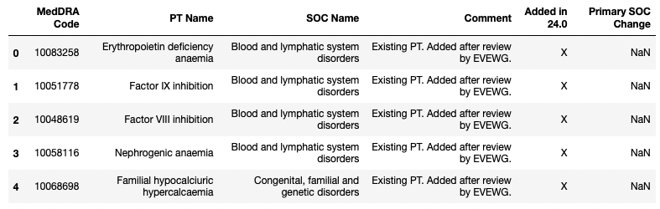
IME LIST
Notes:
The verbatim for serious AE is found under the PT name column of the IME list

Slide 12
Creation of ‘Serious’ Column as Target Variable
Columns Representing Serious Criteria
Columns for Important Medical Events (IME)
The IME list can be found from MedDRA
died
l_threat
symptom1
symptom2
hospital
x_stay
symptom3
symptom4
disable
birth_defect
symptom5
Serious
IME list
Notes:
There are a few columns for some of the serious criteria, namely ‘died’, ‘l_threat’, ’hospital’, ‘x_stay’, ‘disable’, ‘birth defect'
If they indicated ‘Y’ to any one of these columns, the case will be marked as serious
Columns for IME is represented under symptomX, if the symptom is found in the IME list, it would be marked as serious

Slide 13
DATASET AFTER CLEANING
FEATURES
DESCRIPTION
32
543k
COLUMNS
ROWS
28 Non-Text Columns
4 Text Columns
Merged into a single dataset
Target Feature: ‘serious’
Notes:
After cleaning the dataset, we’re left with 32 columns and 543 thousand rows merged into a single dataset
With 28 non-text columns and 4 text columns.
We will be focusing on the 4 text columns we’re doing NLP
The target feature is the column ‘serious

Slide 14
02
EXPLORATORY DATA ANALYSIS
Pre-processing of Data
Data Visualisation

Slide 15
PRE-PROCESSING OF TEXT COLUMNS
REMOVE STOPWORDS
REMOVE PUNCTUATIONS
VECTORIZATION
TOKENIZATION
LEMMATIZATION
Exclude words that are frequently occuring in all text
Clean text of any punctuations
Count Vectorizer
TF-IDF Vectorizer
Splitting text into a list of words
Reducing all words to their base form
Notes:
for pre-processing of data, we have 5 general steps that were carried out
Firstly punctuations were removed from the text
It was then tokenized meaning the text was split into a list of words
Stopwords were removed that excluded words that are frequently occurring in all text
Lemmatizing was performed to reduce all words to their base form
The words were then vectorized with either count vectorizer or tfidf vectorizer to prep for processing
Count Vectorizer
Count Vectorizer converts words into document-term matrix where each row represents a AE record and each column represents a word in the record. Each cell in the matrix represents the word count in the record. The column names represent the unique words used in this dataset.
TF-IDF
TF-IDF is a numerical statistic intended to reflect the importance of a word in relation to the document in a corpus. Similar to Count Vectorizer, each row represents a AE record and each column represents a word in the record. However, each cell represents a weighting meant to represent how important a word is to a document.
The TF-IDF value increases proportionally to the number of times a word appears in the document and is offset by the number of documents in the corpus that contain the word, hence adjusting for words that appear more frequently in general.

Slide 16
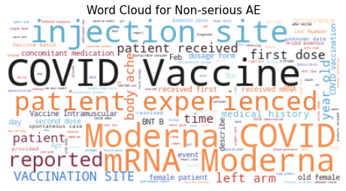
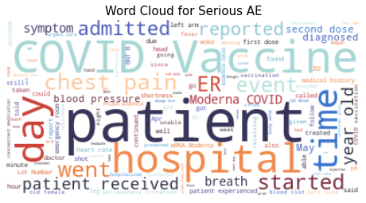
Word Cloud – symptom_text
Notes:
From the word cloud, there are several words with relatively large count in both. These words tends to pertain to the respective category.
For non-serious AE we find words pertaining to milder symptoms such as 'injection site' possibly referring to injection site discomfort/pain.
For serious AE, we find words relating to more serious AE start to appear such as 'chest pain' 'hospital' and 'admitted’.
In both word clouds, we see some common words (e.g. COVID vaccine, patient) that could possibly add these as customized stopwords
So next, we’ll move on to looking at n-grams

Slide 17
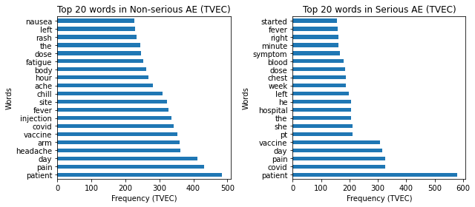
Unigram – symptom_text
Notes:
So this is the unigram for the column symptom_text
Common words across both unigrams include 'patient', 'covid', 'vaccine’. As these words are general terms used while describing both types of adverse events, it is unsurprising we see them in both unigrams.
Despite these commonalities, there are also words that are unique to each category.
As expected, for serious AE, words pertaining to more serious symptoms tend to surface (e.g. 'chest', 'blood', 'hospital’)
while for non-serious AE the words tend to pertain to milder symptoms (e.g. 'arm', 'headache', 'fever’).
Unigrams give us a glimpse into the distinguishing factors between the 2 categories, but let’s see if we can gain more insights from bigrams

Slide 18
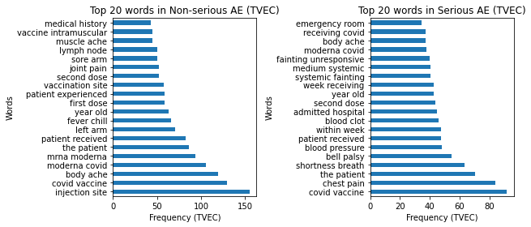
Bigram – symptom_text
Notes:
The bigrams show more distinct difference between the top phrases between each category.
For serious AE, we see word pairs like 'chest pain', 'shortness breath', 'blood clot' which are symptoms that possibly signal to more severe conditions such as a heart attack or stroke.
On the other hand, non-serious AE yielded word pairs such as 'injection site', 'body ache', 'fever chill' which are milder expected AE.
In both bigrams, we find some common pairs such as 'covid vaccine’, 'year old' which do not have much relation to severity, hence we will add them to the list of additional stopwords.

Slide 19

New Stopwords
Words that do not have predictive power or are too repetitive were added to the list of new stopwords

Slide 20
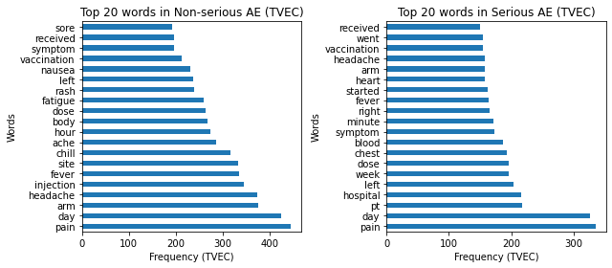
Unigram – symptom_text
Notes:
The unigram looks quite similar to those before removal of additional stopwords.

Slide 21
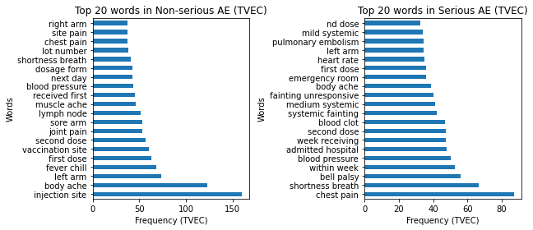
Bigram – symptom_text
Notes:
For the updated bigram, we find the same symptoms for both categories as before
However, we find that an element of time as surface in both bigrams
For non-serious AE, we see the pair ‘next day’ appearing, suggesting that NS AE tend to have very short onset of action
Similarly for serious AE, we find word pairs such as ‘within week’, ‘week receiving’ which suggest that patients receiving covid vaccines generally experience symptoms q quickly though not as fast as NS AE.

Slide 22
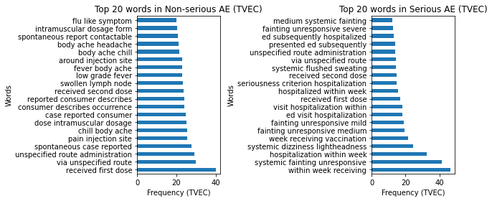
Trigram – symptom_text
Notes:
For trigram, we see a continuation of mention of timeframe e.g. 'within week receiving', 'hospitalization within week' and 'week receiving vaccination' which agrees with the findings from above.
For trigrams we see an interesting pattern with phrases related to fainting such as 'systemic fainting unresponsive', 'systemic dizziness lightheadness', 'fainting unresponsive medium', 'fainting unresponsive mild'. This may be due to the fact that if someone faints and is unresponsive, they may be rushed to the emergency department and hospitalised for observation (hospitalisation being a serious criterion) leading them being classified as serious.

Slide 23
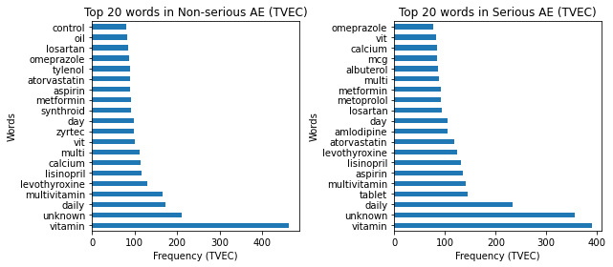
Unigram – other_meds
Notes:
I also tried to look at other text columns such as other_meds
We find the top 'medication' taken is a vitamin supplement in both categories.
There does not seem to be any medications or class of medication that seem to have a correlation a particular category.
The common medications seen then to be chronic in nature (e.g. 'lisinopril', 'atorvastatin') or commonly prescribed for minor ailments (e.g. 'tylenol', 'zyrtec')
Top words for non-serious: levothyroxine, lisinopril, zyrtec, metformin, aspirin, atorvastatin, tylenol, omeprazole, losartan
Top words for serious: aspirin, lisinopril, lecothryoxine, atorvastatin, amlodipine, losartan, metoprolol, metformin, albuterol, omeprazole

Slide 24
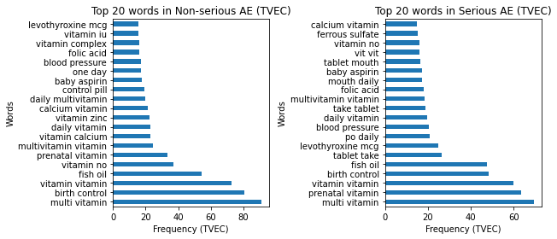
Bigram – other_meds
Notes:
Even the bigram shows us that most concomitant medications are indeed health supplements such as 'multi vitamin', 'fish oil' and 'prenatal vitamin'.
Most of the phrases from the bigram have appeared within the unigram.
Interestingly, we find birth control in both categories of bigram despite not being mentioned in the unigram.
This would be a possible area to look into the relationship between birth control and incidence of AE.

Slide 25
DATASET AFTER EDA
‘symptom_text’
‘serious’
Column for NLP
Target Column
Notes:
After EDA of the dataset, we have determined the column ‘symptom_text’ to have the most predictive words compared to the rest of the text columns
Hence it will be used as the column for NLP
Our target column still remains as serious

Slide 26
03
MODELLING
Modelling
Optimisation
Model Evaluation

Slide 27
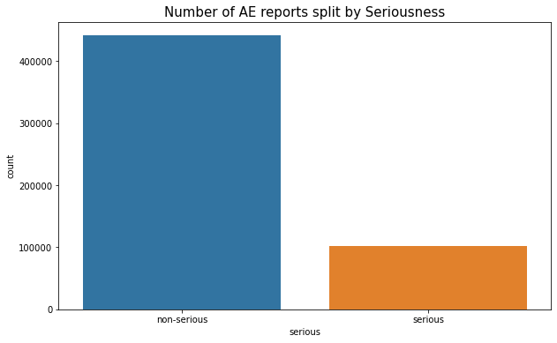
Imbalanced Dataset
Notes:
Looking at the distribution for our target feature, we find a mildly imbalance dataset with only 20% of the data categorized as serious and the rest as non-serious
This means that we may look into ways to deal with this imbalance such as SMOTE

Slide 28
Train-Test-Split
MODELLING
Hyperparameter tuning done via GridSearchCV
10% of records (50k rows)
90% of records
Train the model
Testing
Notes:
Our first step in modelling is performing a train-test-split
With 10% of the post aka 50k rows to train the model
And 90% to test the model
Hyperparameter tuning was done via GridSearchCV

Slide 29
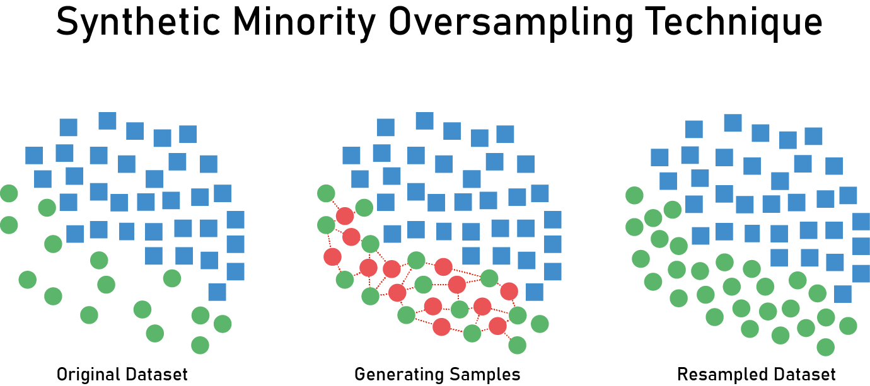
SMOTE
Notes:
As mentioned before, since our dataset is imbalanced with only 20% minority class (serious AE), we will try to use Synthetic Minority Oversampling Technique (SMOTE) to see if it yields better results.
SMOTE is a technique of oversampling the minority class. This is achieved through the generation synthetic examples by drawing a line between examples in the minority class and drawing a new sample point along that line. This produces a more balanced dataset while not providing any additional external information to the model.

Slide 30
MODELS USED
Logistic Regression (LR)
Multinomial Naïve Bayes (MNB)
Random Forest Classifier (RFC)
Ada Boost Classifier (ADA)
Fits data on a sigmoid curve to distinguish the 2 categories
Combines weak classifiers into a single strong classifier
Support Vector Machine (SVM)
Uses conditional probability for classification
Create a hyperplane between the 2 categories
Ensemble of decision trees to vote on the predicted class
Notes:
I have chosen 5 models to use for modelling
LogReg fits data on a sigmoid curve to distinguish between the categories
Multinomial Naïve Bayes uses conditional probability for classification
Random forest is an ensemble of decision trees to vote on the predicted class
ADA combines weak classifiers (aka stumps) into a single strong classifier
SVM creates a hyperplane between the 2 categories

Slide 31
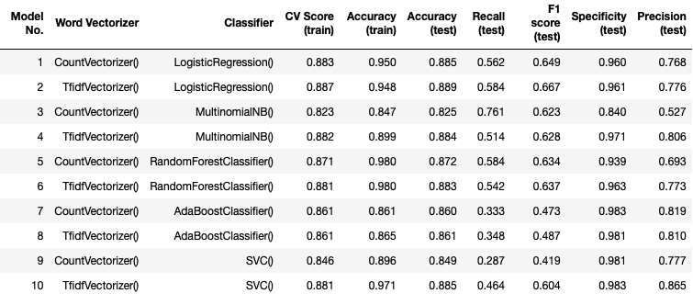
MODEL RESULTS
Without SMOTE
Notes:
From our first round of modelling without SMOTE, we find logreg with tfidf vect to have the best test accuracy and f1 score, with lower overfitting as compared to the top performer for train accuracy.
From this round, we find that logreg is the best model
We’ll try modelling with SMOTE next

Slide 32
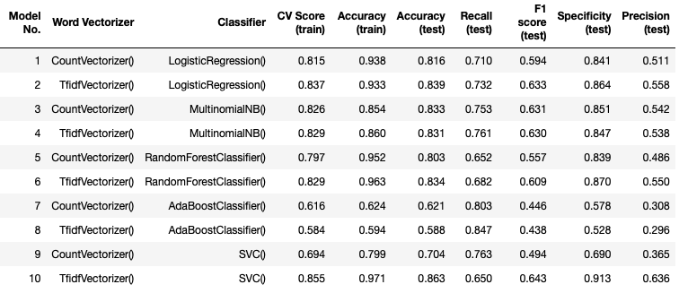
MODEL RESULTS
With SMOTE
Notes:
SVC seems to be the top model using SMOTE, with it having the best metrics in everything except train accuracy and recall.

Slide 33
MODEL COMPARISON
Top models from SMOTE/non-SMOTE
Test (Train) | CV Score | Accuracy | Recall | F1 Score | Precision
LR (TVEC) No SMOTE | 0.887 | 0.889 (0.948) | 0.584 | 0.667 | 0.776
SVC (TVEC) SMOTE | 0.855 | 0.863 (0.971) | 0.650 | 0.643 | 0.636
Notes:
Let’s compare our top model from SMOTE/non-SMOTE to get a better comparison between the model
We find that the non-SMOTE logreg outperforms SMOTE SVC in all metrics except recall
This is surprising as we would expect SMOTE to help improve the overall performance of the model
A possible reason is that the dataset is not heavily imbalance, with 20% as the minority class
With the use of 50k as the train data, we have around 10k rows to train on for serious AE which may be a large enough sample size for the model to train on.
Additionally, the oversampling of minority class may give a true representation of the real life distribution and led to our model overfitting to the train
However we find that modelling with SMOTE does not yield better results as compared to using the mild imbalanced dataset. A possible reason for this is that while oversampling our minority class, this may have led to overfitting of the model which is seen in the greater difference between the train and test accuracy scores as compared to our first round of modelling. Another reason is that our minority class makes up around 20% of our dataset, and by taking 90% of the data as the train dataset we still get 10k rows of serious AE, which may be a large enough sample size for the model to train on, hence not requiring imbalance dataset techniques to improve metric scores.

Slide 34
MODEL COMPARISON
Tuning of Train-Test-Split
Test (Train) | CV Score | Accuracy | Recall | F1 Score | Precision
LR (TVEC) 10/90 split | 0.887 | 0.889 (0.948) | 0.584 | 0.667 | 0.776
LR (TVEC) 80/20 split | 0.902 | 0.903 (0.914) | 0.615 | 0.708 | 0.830
Notes:
Next we will try to increase the train dataset up to 80% to see if it yields a better result
We find that this helps to improve all metrics across the board and bumps our F1 score above our target of 0.7

Slide 35
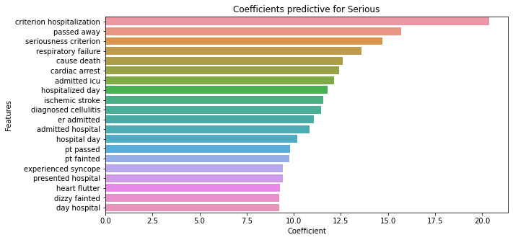
Highest Coefficients
Death
Notes:
The largest coefficients represent words that a predictive of class 1, which is serious AE.
The first trend we see is phrases such as 'Passed away' and 'cause death’ and ‘pt passed’ that is an indication that death has been selected as the serious criteria

Slide 36
Highest Coefficients
Hospitalisation
Notes:
The second trend we see is phrases that pertain to hospitalization such as the ones boxed in red.
Since the words with the highest coefficient seem to represent serious AE rather well, it is no surprise that the misclassification by the model of non-serious AE as serious is rather low with a precision of 0.834.

Slide 37
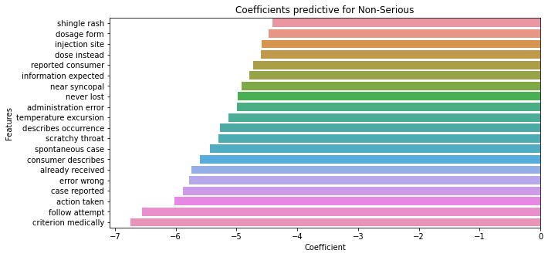
Lowest Coefficients
General words that could be applied to both categories
Notes:
The lowest coefficients represent words that a predictive of class 2, which is non-serious AE. The phrases seems to be more general and less specific as compared to the largest coefficients. Phrases like 'describes occurrence', 'spontaneous case', 'case reported', 'action taken' and 'follow attempt' would be present in both serious and non-serious cases.
Since the words with the lowest coefficient seem to be rather generic, we find the model misclassifying some serious AE as non-serious with a recall of 0.617.

Slide 38
04
CONCLUSION & RECOMMENDATION
Conclusion
Recommendation
Future Plans

Slide 39
CONCLUSION
Accurate Prediction
With a test and train accuracy of at least 90%, the model is able to accurately predict serious AE.
Little Overfitting
With difference between train and test accuracy at 1.1%, the model is not overfitted to the train data.
Easy to Understand
The coefficients from the model is easy to interpret and understand.
Test (Train) | CV Score | Accuracy | Recall | F1 Score | Precision
LR (TVEC) 80/20 split | 90.2% | 90.3% (91.4%) | 61.5% | 70.8% | 83.0%
Notes:
Overall, the chosen model is successful in meeting the requirements of the problem statement.
The model is able to make accurate predictions with a train and test accuracy of more than 90%
With the difference between the train and test accuracy at 1.1%, the model is not overfitted to the train data
LogReg is easy to unds as we can interpret the coefficients, with the largest being indicative of serious class and lowest of non-serious

Slide 40
RECOMMENDATION
Deploy model as a preliminary screening tool for all incoming AE, allows serious cases to be labelled more quickly thus enabling signal detection to occur more efficiently
Notes:
Since our model is able to accuracy classify serious AE,
it could be implemented as a preliminary screening tool for all incoming AE reports,
to get an initial seriousness classification.
This would help to enable serious reports to get expedited and processed more quickly,
enabling signal detection to occur more efficiently.

Slide 41
FUTURE IMPROVEMENTS
Expand Data Collection to Non-AE reports
Incorporate Non-Text Columns
Use of Deep Learning
Explore use of Neural Networks to possibly improve predictive power.
Use of non-text columns in model to improve model performance.
Would allow expansion of classification scope of model (AE vs non-AE report).
Notes:
Obtain further data to expand scope of model
Since there is a low rate of reporting AE in Singapore,
it would be helpful to look into expanding this model to be able to classify between an AE report vs non-AE report.
With such a model, it would be possible to try to obtain AE reports from retrospectively looking at electronic medical reports
to sieve out potential AE instead of relying passively for people to report cases.
Use of deep learning techniques through neural networks
As neural networks are able to learn and model non-linear and complex relationships,
it could possibly be used to classify reports more efficiently as it would be able to distinguish nuance difference through optimisation of the layers.
Incorporate use of non-text columns into model
The use of non-text data could be included into training of the model to help produce a more robust model.

Slide 42
THANKS!
Do you have any questions?
facebook.com/Freepik
@Freepik_Vectors
company/freepik-company
Please keep this slide for attribution

Slide 43
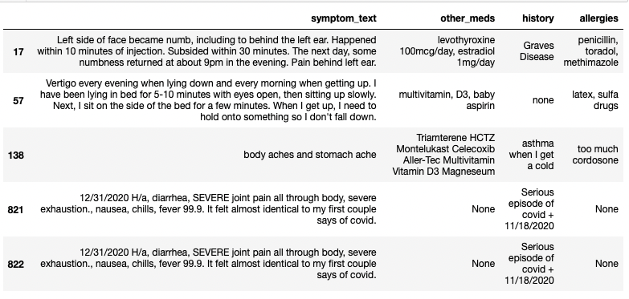
APPENDIX
Regex
Notes:
Regex: clean special characters, digits and non-English symbols

Slide 44
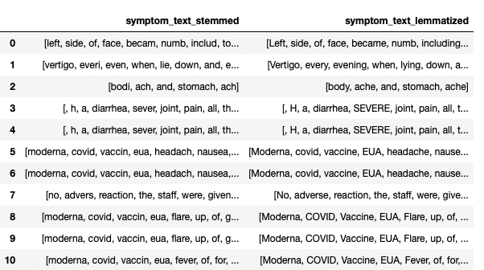
APPENDIX
Stemming vs Lemmatizing
Notes:
Stemming is the process of reducing inflection in words to their root forms by mapping a group of words to the same stem even if the stem itself is not a valid word in a particular language. Hence, there are words that do not necessarily make sense (e.g. everi, headach and vaccin).
On the other hand, lemmatizing reduces the number of nonsensical words by ensuring that the root word (lemma) belongs to the language. A lemma is the dictionary form of a set of words, and provides better word quality (e.g. every, headache and vaccination).
Lemmatizing will be the chosen method moving forward

Slide 45
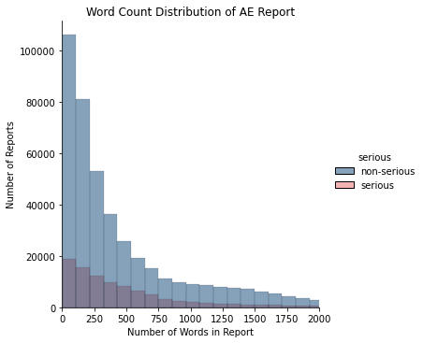
Word Vectorization
Count Vectorization
TF-IDF Vectorization
N-gram frequency
Notes:
Count Vectorizer
Count Vectorizer converts words into document-term matrix where each row represents a AE record and each column represents a word in the record. Each cell in the matrix represents the word count in the record. The column names represent the unique words used in this dataset.
TF-IDF
TF-IDF is a numerical statistic intended to reflect the importance of a word in relation to the document in a corpus. Similar to Count Vectorizer, each row represents a AE record and each column represents a word in the record. However, each cell represents a weighting meant to represent how important a word is to a document.
The TF-IDF value increases proportionally to the number of times a word appears in the document and is offset by the number of documents in the corpus that contain the word, hence adjusting for words that appear more frequently in general.

Slide 46
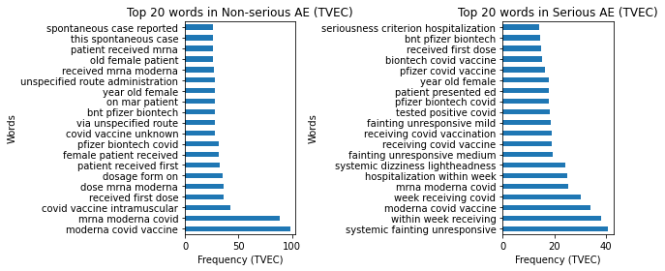
Trigram – symptom_text
Notes:
* From the trigram, we find certain themes for each category.
* For serious AE, we find 3 out of the top 5 referencing AE occuring within the week 'within week receiving', 'week receiving covid' and 'hospitalization within week'. This suggests that serious AE tend to occur within the first week of receiving the vaccine.
* For non-serious AE, we find more trigrams pertaining to the route of administration, such as 'covid vaccine intramuscular', 'via unspecified route' and 'unspecified route of administration. This could be due to most non-serious AE relating to injection site pain/discomfort, hence mention of the route of administration is more common in these reports.

Slide 47
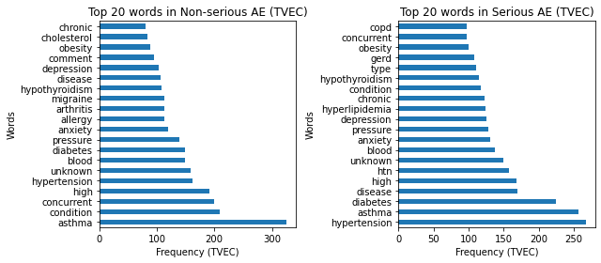
Unigram – history
Notes:
The concomitant disease seem to be in line with the population statistics (source) with top chronic diseases such as 'hypertension/high blood pressure', 'high cholesterol' and 'diabetes' appearing in all the N-grams.

Slide 48
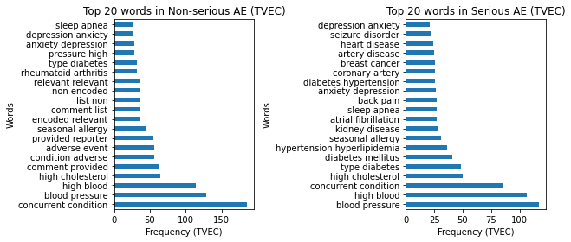
Bigram – history
Notes:
* From the trigram, we find certain themes for each category.
* For serious AE, we find 3 out of the top 5 referencing AE occuring within the week 'within week receiving', 'week receiving covid' and 'hospitalization within week'. This suggests that serious AE tend to occur within the first week of receiving the vaccine.
* For non-serious AE, we find more trigrams pertaining to the route of administration, such as 'covid vaccine intramuscular', 'via unspecified route' and 'unspecified route of administration. This could be due to most non-serious AE relating to injection site pain/discomfort, hence mention of the route of administration is more common in these reports.

Slide 49
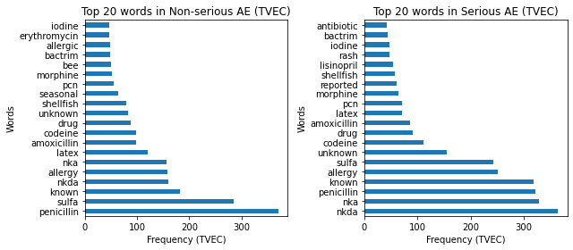
Unigram – allergies
Notes:
The unigram looks quite similar to those before removal of additional stopwords.

Slide 50
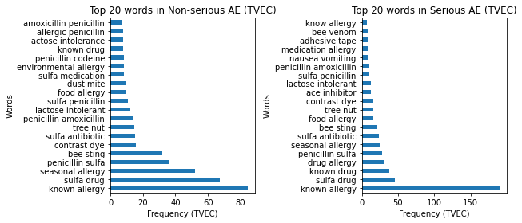
Bigram – allergies
Notes:
The top allergies from the N-grams correspond to the most common food, drug and outdoor allergies (e.g. 'penicillin', 'sulfa drug', 'tree nut', 'bee sting') (source).

Slide 51
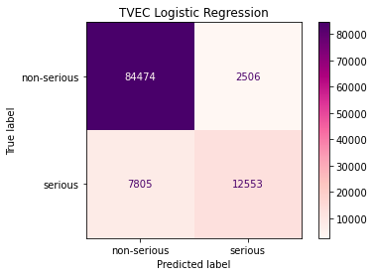
APPENDIX
Confusion Matrix
Notes:
The confusion matrix allows us to evaluate the performance of a classification model (in this case Logistic Regression), as it allows a comparison of the actual target label against the predicted label. This gives us a hoslistic view of how well the model is performing and what kind of errors it is making.
From the confusion matrix, we see the model misclassifying serious as non-serious accounting for the lower recall score.
Conversely, we see that the model is misclassifying only a handful of non-serious AE as serious, which is seen in the high precision score.

Slide 52
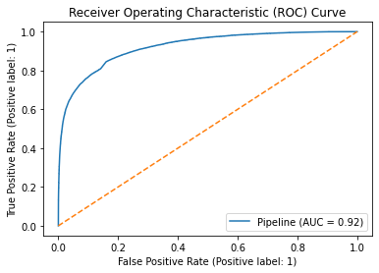
APPENDIX
ROC-AUC
Notes:
The ROC (receiver operating characteristic) curve AUC (area under the curve) enables us to visualise the performance of a classification model. ROC is a probability curve and AUC represents the degree of separability, meaning how well the model is able to distinguish between the different classes. The higher the AUC, the better the model is at distinguishing between serious and non-serious AE.
The AUC of 0.92 is indicates that model is able to distinguish between serious and non-serious AE 92% of the time.

Slide 53
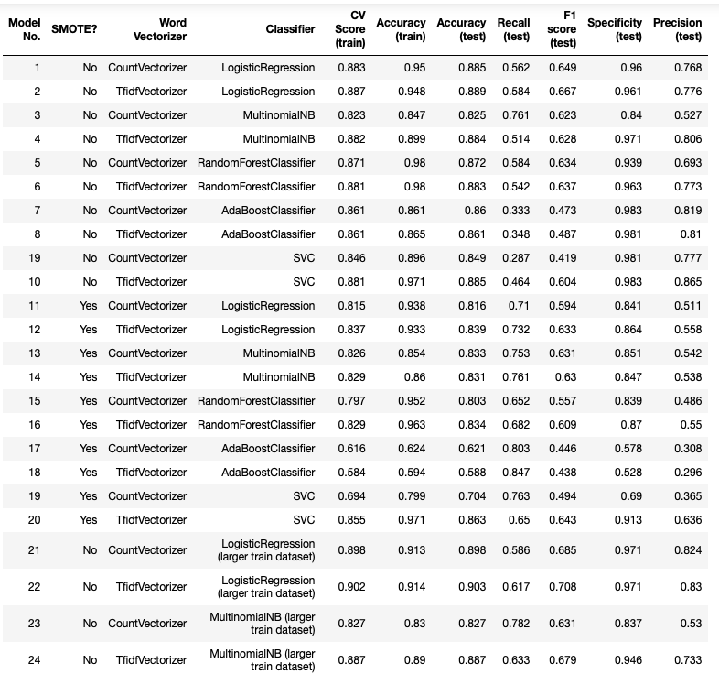
APPENDIX
All models

Slide 54
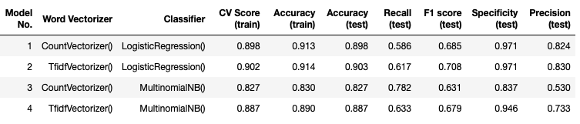
APPENDIX
80/20 train-test split

